Slide 1

UNIVERSITY INSTITUTE OF ENGINEERING
DEPARTMENT OF AIT - CSE
Bachelor of Engineering (CSE)
Security and Data Privacy Laws and Standards (21CSF-433)
By: Ms. Merry K.P(E12903)
Assistant Professor
AIT CSE
Lecture-10
Protecting Programs and Data & Information and Law
DISCOVER . LEARN . EMPOWER

Slide 2
Chapter | Course Objectives
1.3 | Understand the unique challenges posed to law enforcement agents, policy makers and prosecutors
Chapter | Course Outcomes
1.3 | After completion of this course, the student will be able to Describe the legal requirements for the use of Trusted data, data collection, and storage.

Slide 3
Contents
1.3 Legal, Privacy and Ethical Issues in Computer Security
Protecting Programs and Data

Slide 4

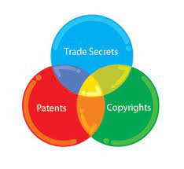
Protecting Programs and Data
Journal Articles
Conference Articles
Intellectual Property

Slide 5
IPR Basics – Brief overview

Slide 6
Intellectual Property (IP)
IP is basically an Intangible Property that is created at the mind of human before being converted in to material form.

Slide 7
Types of Property
Tangible
That which can be measured, touched & have physical forms.
Ex. Currency, Gold, House, land, industry etc.
Intangible
That which cannot be measured, touched not having any physical forms
Creation of the human mind/ intellect
Ex: Ideas

Slide 8

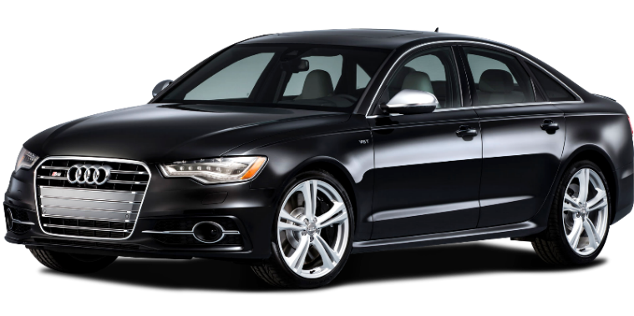



Tangible Property
Intangible Property
8

Slide 9
Types of Intellectual Property (IP)
Innovative ideas
New process
New Product
Design
Literary / artistic work
Logo / Brand name / Symbol

Slide 10
Intellectual Property Rights (IPR)
In the current knowledge-driven, private sector oriented economic development paradigm, the different types of intangible assets of a business are often more important and valuable than its tangible assets.
Intellectual Property Rights (IPR) are the exclusive rights over creation of human mind.
A creator can have exclusive rights over his / her creations for a certain fixed period of time depending upon the type of IP.
These rights are granted by designated Government Authorities after due process and as per the IPR law framework of that country i.e. IP Rights are Territorial in Natures

Slide 11
Significance of Intellectual Property Rights (IPR)
To provide incentive to an individual for new creation
Recognition to creators and inventors
Ensuring material reward for IP
Ensuring availability of genuine and original products

Slide 12
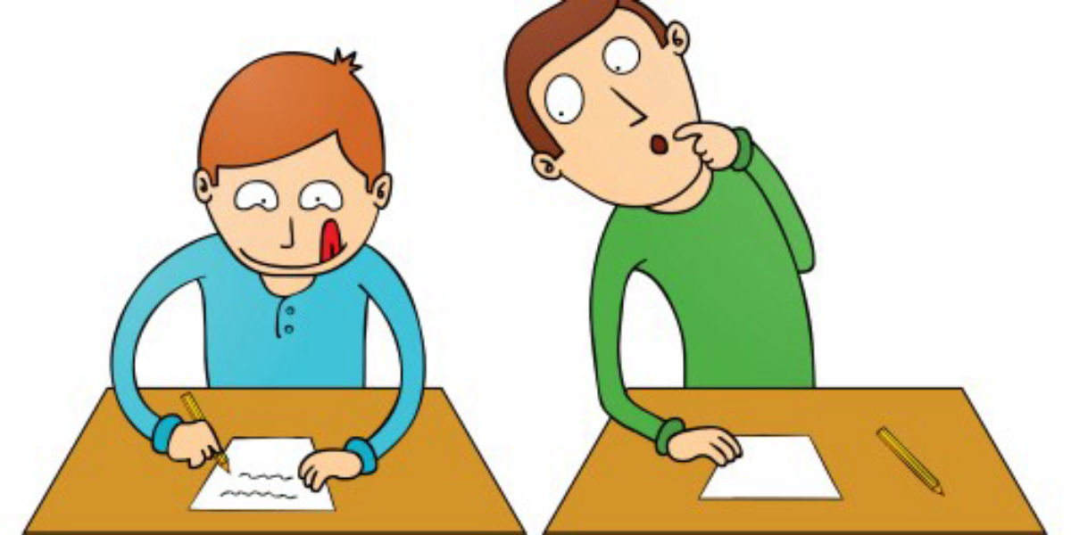
Plagiarism
Steeling others ideas or work is an offence. It's known as IP theft.

Slide 13
Types of Intellectual Property Rights (IPR)
Intellectual Property Rights (IPR) confers the right of ownership through several ways.
Patents
Trade mark
Copyrights
Design
Geographical Indication
Semiconductor Circuit Lay out design
Plant variety and Breeder’s Right Protection
Trade Secrets

Slide 14
Intellectual Property-Evolution
Idea Expression COPYRIGHT
Idea Innovation Invention PATENT
Idea Quality + Identity TRADEMARK
Idea Appearance DESIGN
Idea Keep Confidential No Disclosure
TRADE SECRETS

Slide 15
Patents
The exclusive right granted by a Government to an inventor to manufacture, use, distribute or sell an invention for a certain number of years.
It also can be describe as: A new way of doing something, or offers a new technical solution to a problem.
Patent provides protection to the invention by the means that it cannot be commercially that is it can not be Made, Used, Distributed or Sold WITHOUT the patent owner's CONSENT.
A patent is Obtained by the inventor/assignee by Filing an application with the Patent Office.

Slide 16
Patents
In the stipulated forms as required by the Patent Act of the Country.
The term of every patent shall be 20 years from the date of filing of the application for the Patent.
It is mandatory to pay Renewal fees should be paid at every respective years.

Slide 17
Examples of some Important Invention Protected through Patents

Slide 18
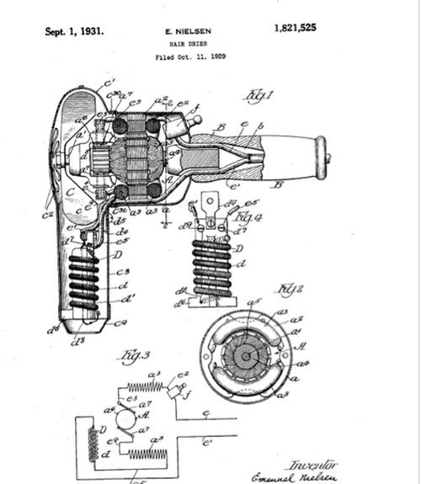
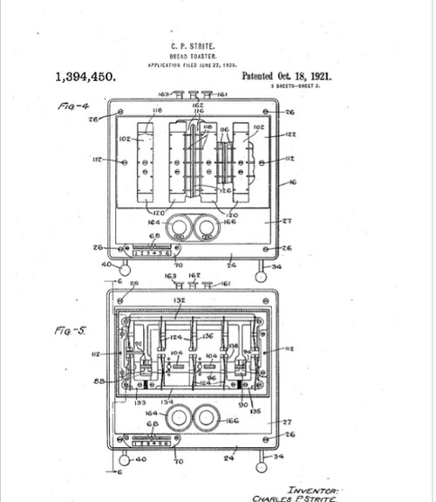
Patent No. 1,821,525
Hair dryer by E. Nielsen, 1931
Patent No. 1,394,450
Bread Toaster by Charles P. Strite, 1921

Slide 19
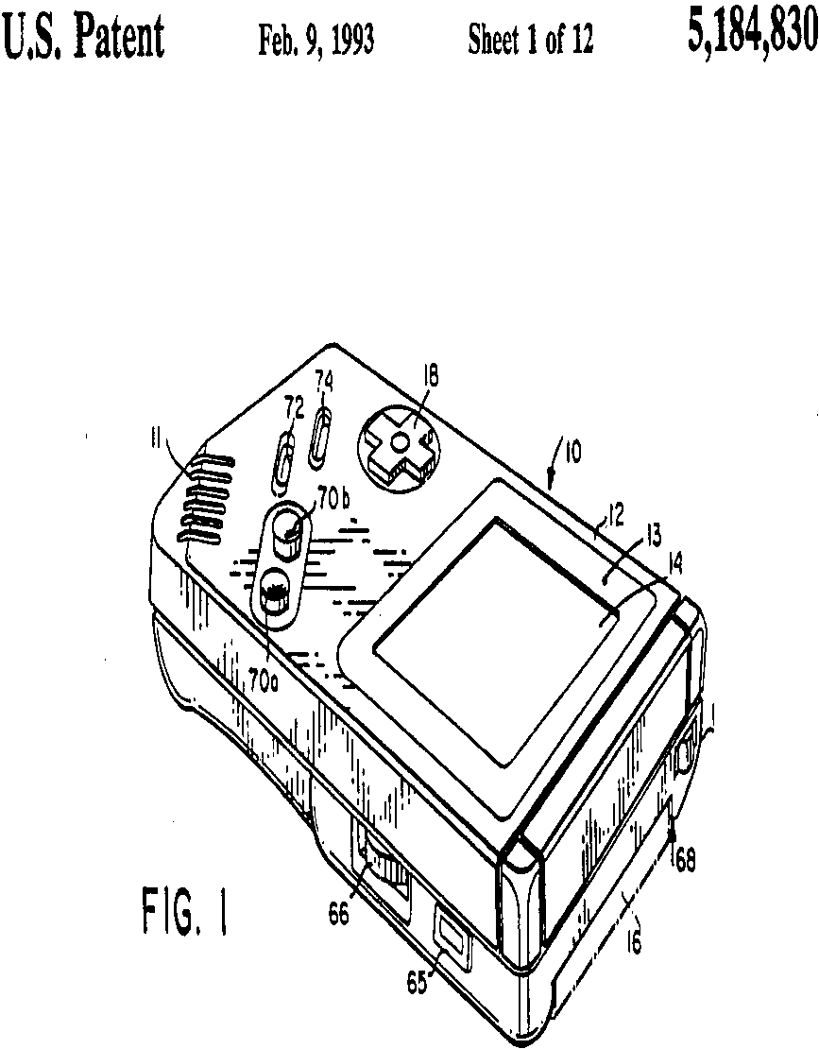
Patent no. 5,184,830 Compact Hand-Held Video Game System (Game Boy) by Nintendo, 1993

Slide 20
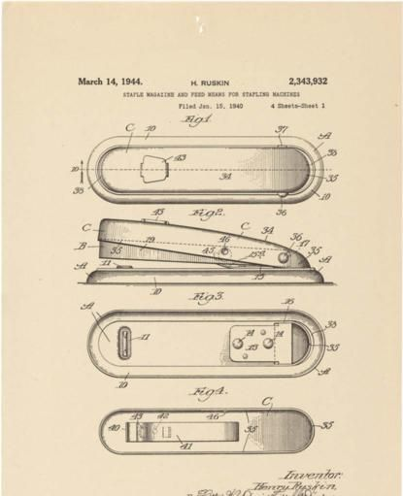
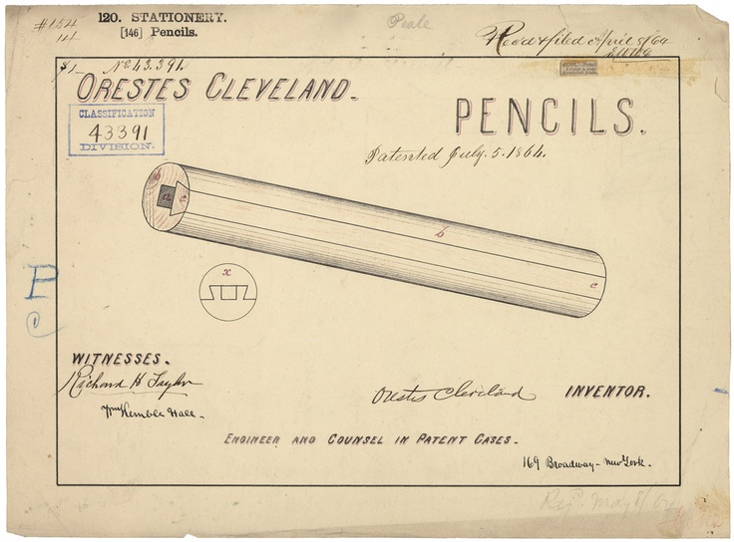
STAPLER 1944
PENCIL 1864

Slide 21
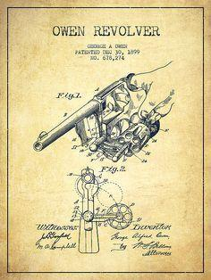
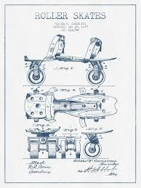
Revolver - 1899
SKATES - 1864

Slide 22
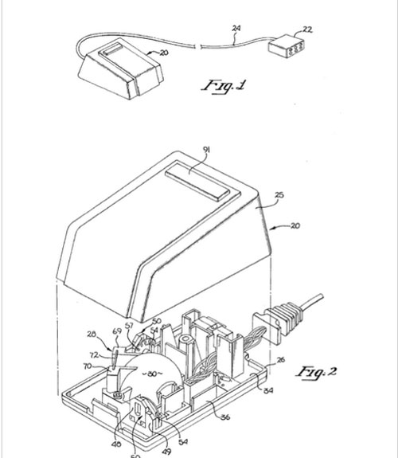
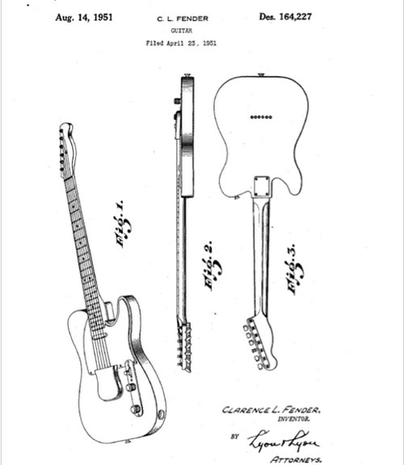
Patent No. 4,464, 652, Lisa Mouse. by Apple Computer, Inc., 1984
Patent No. 164,227
Electric Guitar. by C.L. Fender, 1951

Slide 23
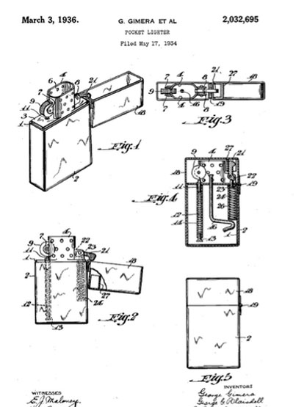
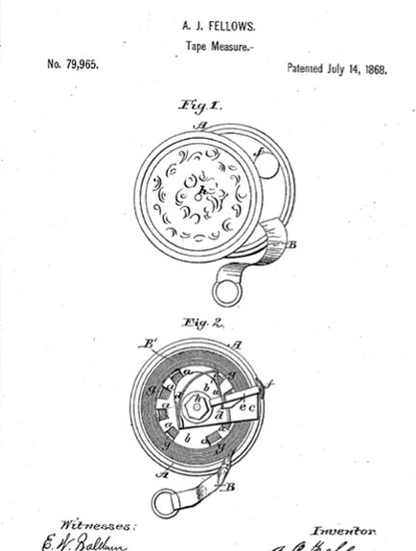
Patent No. 2,032,695, Pocket Lighter (Zippo). 1936
Patent No. 79,965 Tape Measure, by A.J. Fellows, 1868.

Slide 24
Criterion for Patentability
Patentability of any Invention has to follow the principle of “3 I”
Innovativeness (Novelty)
Inventive Step (Non-obviousness)
Industrial Utility (Usefulness)

Slide 25
Criterion for Patentability
Invention [U/s 2(1)(j)]: It means a new product or process involving an inventive step and capable of industrial application
Inventive Step [U/s 2(1)(ja)]: It means a feature of an invention that involves technical advancement as compared to the existing knowledge or having economic significance or both and that makes the invention not obvious to a person skilled in the art.
Capable of industrial application [U/s 2(1)(ac)]: In relation to an invention, it means that the invention is capable of being made or used in an industry;

Slide 26
Criterion for Patentability
New invention [U/s 2(1)(l)]: It means any invention or technology which has not been anticipated by,
Publication in any document OR
Used in the country OR
Elsewhere in the world
Before the date of filing of patent application with complete specification, i.e., the subject matter has not fallen in public domain or that it does not form part of the state of the art

Slide 27
Don’ts to a Patent
One advice is to Stay Away From:
Publications-that includes: Internet, Newspapers, Poster presentations etc.
Award Competition-that includes: Events, Workshops, Seminars, Conferences etc.
Public Display-that includes: Fairs, Public Places etc.
Public Working-that includes: Production, Marketing etc.

Slide 28
Summary
Awareness about data protections
Security Protecting Programs and data

Slide 29
Home Work
Q1. In which form the data protection could obtain in an organization.

Slide 30
References
Text Books:
V. D. Dudeja ,”Cyber Crime and Law Enforcement”, Commonwealth Publishers, 2003.
C. Davis,”IT Auditing: Using Controls to protect Information Assets”, TMH, 2011.
Reference Books:
Paul van Oorschot, computer Security and the Internet: Tools and Jewels (2020, Springer). Personal use copy freely available on author's web site.
Wenliang Du, Computer Security: A Hands-on Approach (2017, self-published). Updated May 2019.
Online References:
What is Data Protection and Why Do You Need It?: https://www.youtube.com/watch?v=SuNtmCgIhiM
Data Protection in Software Development: https://www.youtube.com/watch?v=mxusGZtPLos

Slide 31
THANK YOU
For queries
Email: merry.e12903@cumail.in

